Slide 1
Effectively Managing Pregnant Patients with Substance Use Disorder:
A Roadmap for Care Providers
Davina Moss-King, Ph.D.
Positive Direction and Associates, Inc.
March 17, 2018

Slide 2
Disclosures
Dr. Moss-King has nothing to disclose with regard to commercial relationships.
The content of this presentation does not relate to any product of a commercial interest.
Dr. Moss-King does not have relevant financial relationships to disclose.
Some of the content in this training was provided by ACOG District II with permission
The training “Effectively Managing Pregnant Patients with SUD: A Road Map for Providers” is being sponsored by The Peter and Elizabeth C. Tower Foundation.

Slide 3
Objectives
Understand Substance Use Disorder
  How and Where Does Dependence Begin
  Impact for Pregnant Patients
  Appropriate behaviors | language = compassion
Establish Your Practice Philosophy & Awareness of Hospital Experiences
  If OBGYN office – commitment to screening, plan for treatment or referral and awareness of birthing hospital’s approach
  If Mental Health or Chemical Dependency Provider – commitment to prioritize pregnant patients and work collaboratively with OBGYN and birthing hospital, know each hospitals approach
Understand importance of Motivational Interviewing
Incorporate Trauma Informed Care concepts
Consider Positive Direction Model/Toolkit as Roadmap

Slide 4
Understanding Opioid Use Disorder
In Pregnancy: Know the Basics
First Steps

Slide 5
Addiction
Primary chronic disease of brain reward, motivation, memory and related circuitry.
  - Dysfunction in these circuits leads to psychological, social and spiritual manifestations.
Reflected in pathologically pursuing reward and/or relief by substance use and other behaviors.
Like other chronic diseases, addiction often involves cycles of relapse and remission / recovery
Without treatment and self – motivation , addiction is progressive and can result in disability or death.
Source: ASAM Public Policy Statement on Treatment for Alcohol and Other Drug Addiction, Adopted: May 01, 1980, Revised: January 01, 2010 https://www.asam.org/resources/definition-of-addiction
Notes:
Speaker notes:
Addiction is a primary, chronic disease of brain reward, motivation, memory and related circuitry.
Dysfunction in these circuits leads to characteristic biological, psychological, social and spiritual manifestations.
This is reflected in an individual pathologically pursuing reward and/or relief by substance use and other behaviors.
Addiction is characterized by inability to consistently abstain, impairment in behavioral control, craving, diminished recognition of significant problems with one’s behaviors and interpersonal relationships, and a dysfunctional emotional response.
Like other chronic diseases, addiction often involves cycles of relapse and remission. Without treatment or engagement in recovery activities, addiction is progressive and can result in disability or premature death.

Slide 6
OUD – Four Components
3. Lifestyle
1. Heroin (Love)
2. Culture
4. Needle Obsession / Ritual
(Moss-King, 2009)
Notes:
Women that have difficulty in recovery are often attached to the opioid and if pregnant may have difficulty attaching to their infant after birth
Addicted to the lifestyle and culture may prohibit the woman from seeking assistance to change her environment which can have negative consequences for the infant
Needle obsession and ritual can have a negative effect for the woman to be preoccupied on the substance and not totally focused on the infant and his / her needs which can result in Reactive Attachment Disorder.

Slide 7
Attachment to Drug of Choice
Predictable
Secure attachment (Despite the consequences)
Inability to “let go”
Emotional bond
  Can’t live without
  Strong love affair
  Strong desire to use
  Inability to function (ADL Skills)
Notes:
1. Transition to the DSM 5

Slide 8
DSM -V Diagnostic Criteria: OUD & SUD
A minimum of 2-3 criteria is required for a mild substance use disorder diagnosis, while 4-5 is moderate, and 6 or more is severe
  Taking the opioid in larger amounts and for longer than intended
  Wanting to cut down or quit but not being able to do it
  Spending a lot of time obtaining the opioid
  Craving or a strong desire to use opioids
  Repeatedly unable to carry out major obligations at work, school, or home due to opioid use
  Continued use despite persistent or recurring social or interpersonal problems caused or made worse by opioid use
  Stopping or reducing important social, occupational, or recreational activities due to opioid use
  Recurrent use of opioids in physically hazardous situations
  Consistent use of opioids despite acknowledgment of persistent or recurrent physical or psychological difficulties from using opioids
*Tolerance as defined by either a need for markedly increased amounts to achieve intoxication or desired effect or markedly diminished effect with continued use of the same amount. (Does not apply for diminished effect when used appropriately under medical supervision)
*Withdrawal manifesting as either characteristic syndrome or the substance is used to avoid withdrawal (Does not apply when used appropriately under medical supervision)
*This criterion is not considered to be met for those individuals taking opioids solely under appropriate medical supervision.
Source: APA 2013

Slide 9
Substance Use Disorders
Alcohol Use Disorder (AUD)
Tobacco Use Disorder
Cannabis Use Disorder
Stimulant Use Disorder
Hallucinogen Use Disorder (HUD)
Opioid Use Disorder (OUD)
Substance use disorders occur when the recurrent use of alcohol and/or drugs causes clinically and functionally significant impairment, such as health problems, disability, and failure to meet major responsibilities at work, school, or home.
Source: SAMHSA; https://www.samhsa.gov/disorders/substance-use

Slide 10
Opioid Use Disorder
In 2014, an estimated 1.9 million people had an opioid use disorder related to prescription pain relievers and an estimated 586,000 had an opioid use disorder related to heroin use.
Opioid use disorder is a pattern of opioid use characterized by tolerance, craving, inability to control use, and continued use despite adverse consequences. Opioid use disorder is a chronic, treatable disease that can be managed successfully by combining medications with behavioral therapy and recovery support, which enables those with opioid use disorder to regain control of their health and their lives.
Sources: SAMHSA; https://www.samhsa.gov/disorders/substance-use
ACOG. Opioid Use and Opioid Use Disorder in Pregnancy. Opinion No. 711. ACOG Committee Opinion on Obstetric Practice & the American Society of Addiction Medicine. Replace Opinion No. 524, May 2012. Published August 2017.
Notes:
Speaker Notes:
Symptoms of opioid use disorders include strong desire for opioids, inability to control or reduce use, continued use despite interference with major obligations or social functioning, use of larger amounts over time, development of tolerance, spending a great deal of time to obtain and use opioids, and withdrawal symptoms that occur after stopping or reducing use, such as negative mood, nausea or vomiting, muscle aches, diarrhea, fever, and insomnia.
Emphasize that substance use disorders (SUDs) are chronic medical conditions, treatment is available, family and peer support is necessary and recovery is possible.
Emphasize that opioid pharmacotherapy (i.e. methadone, buprenorphine) and behavioral therapy are effective treatments for OUD
For pregnant women with an opioid use disorder, opioid agonist pharmacotherapy is the recommended therapy and is preferable to medically supervised
withdrawal because withdrawal is associated with high relapse rates, which lead to worse outcomes. – ACOG CO #711

Slide 11
Physical Dependence
“Physical dependence is the physiological adaptation of the body to the presence of an opioid. It is defined by the development of withdrawal symptoms when opioids are discontinued, when the dose is reduced abruptly or when an antagonist (eg, naloxone) or an agonist-antagonist (eg, pentazocine) is administered. ”
Source: O'Brien CP. Drug addiction and drug abuse. In: Goodman and Gilman's The pharmacological basis of therapeutics. 9th edition.
Notes:
Speaker notes:
Physical dependence is a normal and expected response to continuous opioid therapy. Physical dependence may occur within a few days of dosing with opioids, although it varies among patients. Physical dependence (indicated by withdrawal symptoms) does not mean that the patient is addicted.
11

Slide 12
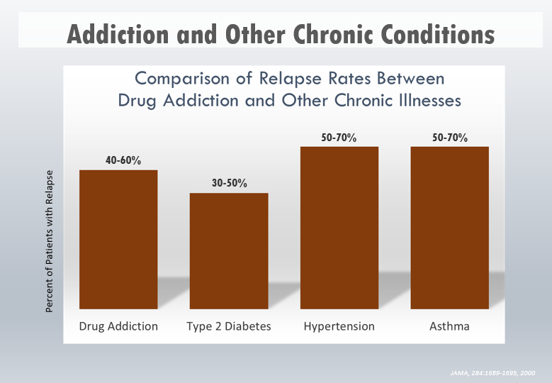
Source: JAMA 284: 1689-1695, 2000
Notes:
Speaker notes:
Relapse rates for drug-addicted patients are compared with those suffering from diabetes, HTN, and asthma. Relapse is common and similar across these illnesses (as is adherence to medication). Thus, drug addiction should be treated like any other chronic illness, with relapse serving as a trigger for renewed intervention – JAMA 284: 1689-1695, 2000.

Slide 13
Women and Opioid Use
Prenatal Care
Public Health Problem
Prescribed medications disproportionately
Complications are caused by the use and misuse of the prescriptions
Reasons for lacking Pre-Natal Care
  Amenorrhea
  Homeless / lack of self-care
  High Risk Behaviors
  Medical Coverage

Slide 14
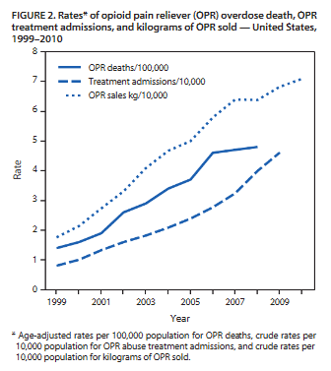
Prescribing Practices
In 2012, providers wrote 259 million prescriptions for opioids, more than enough for every American adult to have a bottle of pills
An estimated 20% of people with a pain-related diagnosis (including acute and chronic) receive an opioid prescription
Chronic pain defined as pain that typically lasts > 3 months or past the time of normal tissue healing. 14 % adults have chronic pain
Opioid use presents serious risks including opioid overdose and opioid use disorder.
Sales of opioids have increased in parallel with opioid related deaths
Source: https://www.cdc.gov/vitalsigns/opioid-prescribing/
https://www.researchgate.net/publication/278354874_Vital_Signs_Overdoses_of_Prescription_Opioid_Pain_Relievers-United_States_1999-2008_Reprinted_from_MMWR_vol_60_pg_1487-1492_2011

Slide 15
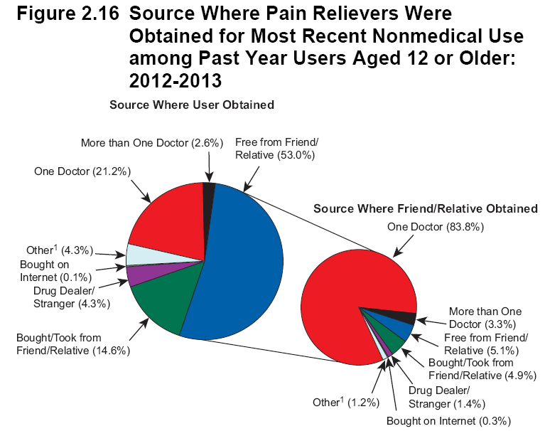

Source: SAMHSA 2013; https://www.samhsa.gov/data/sites/default/files/NSDUH-DetTabs2014/NSDUH-DetTabs2014.htm#tab6-47a

Slide 16
What can we do?
Give information regarding the reactive attachment disorder
Inform care givers of the future complications
Encourage positive thinking
Use motivational Interviewing to encourage intrinsic motivation to change
Discuss the benefits of emotional attachment to the infant
Encourage activities for family bonding.

Slide 17
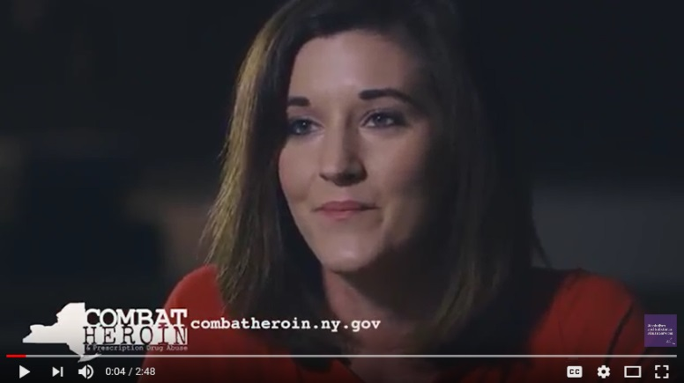


It Can Happen to Anyone
https://youtu.be/Pet6ugDj8CY
https://youtu.be/DbeVhMye9NQ
https://youtu.be/6NBNKvYSWPo
Notes:
Additional Patient Testimonials from Suffolk County:
https://youtu.be/3JUEvleXFpI

Slide 18
People may not remember exactly what you did, or what you said, but they will always remember how you made them feel.
1991 book by H. Jackson Brown Jr. to Maya Angelou.

Slide 19

Reduce the Stigma
Emphasize that stigma, bias and discrimination negatively impact pregnant women with OUD and their ability to receive high quality care.
Change perceptions of opioid use disorder through the use of a common language and emphasize that SUDs are chronic medical conditions that can be treated.
Use appropriate language, approach, inquiry and support.
Created by ACOG District II in 2018
Notes:
Speaker Notes:
Expand upon bullet #1: screen for social determinants of health for example, pregnancy may be an opportunity for women, their partners and other people living in their household to change their patterns of substance use. Providers who care for women with opioid use disorder in pregnancy need to understand the complexity of the woman’s social, mental and physical problems in order to provide appropriate advice and support throughout pregnancy and in the postpartum period. (World Health Organization, 2014)

Slide 20
Words Matter
Use
Alcohol, drug use disorder
  Addiction
  Person with/who…
Opioid Agonist treatment
Medication Assisted Treatment
(Agonist) treatment
Positive/negative (test)
Unhealthy
At-risk, risky, hazardous
Heavy use, episode
(Return to) use
Low risk
  Avoid
  Abuse, abuser, user, addict, alcoholic
  Substitution, replacement
  Clean, dirty
  Misuse*
  Heavy use
  Relapse
  Binge*
  Dependence*
  Problem
  Inappropriate
*Instances where use may be clinically appropriate (eg, dependence for a patient dependent upon prescribed opioids but not addicted)
Source: Boston University School of Public Health

Slide 21
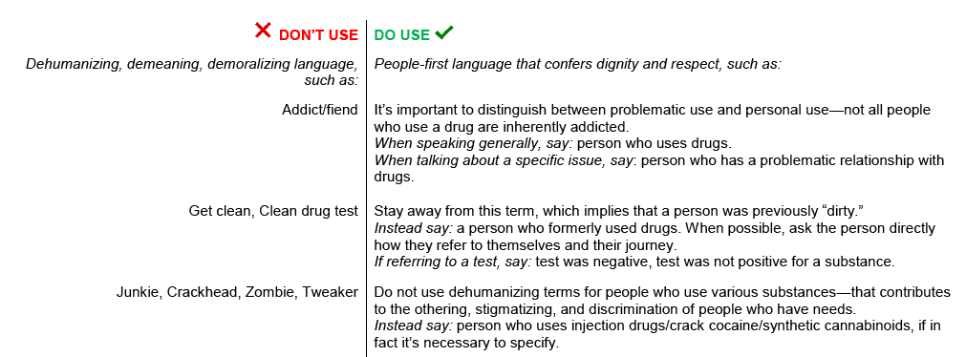
Words Matter

Slide 22
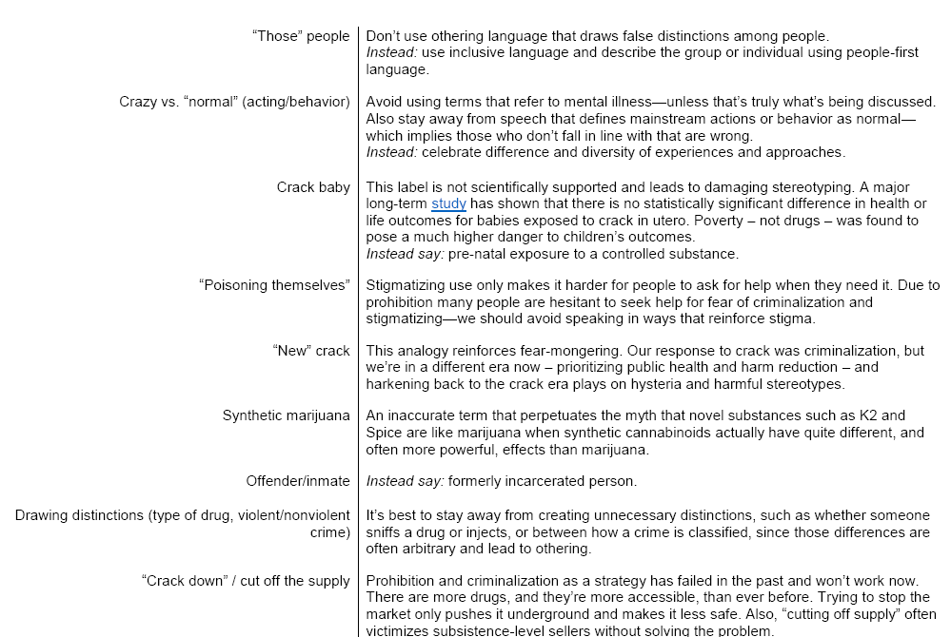
Words Matter

Slide 23
Body Language Matters, too
Use
Genuine compassion – this COULD happen to anyone
Thoughtful interpretation of the patient’s situation – direct eye contact, taking the extra minute to be sure she knows you CARE
Sit at her level and talk with her not at her
Pause often for patient to continue sharing
  Avoid
  Standing over the patient while talking
  Looking away while she is talking – comes across as either inpatient or dismissive
  Crossing your arms in front of patient – implies I am better than you
  Interrupting her talking – you come across as telling not inquiring
*Instances where use may be clinically appropriate (eg, dependence for a patient dependent upon prescribed opioids but not addicted)
Source: Boston University School of Public Health

Slide 24
Establishing Your Practice’s Philosophy
And Approach to Patients with SUD
Next Steps

Slide 25
Professional Education
Improves Outcomes for Mother and Baby
Provide staff-wide (clinical and non-clinical staff) education on SUDs.
Recognize that pregnancy is a great window of opportunity to empower women to care for their baby and, as a result of her care of the baby, benefits herself.
Establish your practice’s approach and be consistent!
What is opioid use disorder and who is affected (universal terminology and definitions for common language) – covered!
Offer strategies to engage the patient and how to overcome barriers in her life to successful outcomes (Navigators can help!)
What medications are appropriate during pregnancy?
  Medication Assisted Treatment (MAT): Methadone vs. Buprenorphine (ie, Subutex/Suboxone) regimens – and accept patients who are NOT willing to take the treatment
Notes:
Speaker Notes:
Focus is on improving health outcomes for both mother and baby
Providers should work with their Regional Perinatal Center to set the standard educational approach to all affiliated hospitals

Slide 26
Practice Approach
Practices should clearly define the approach to screening and testing pregnant patients for opioid use based on what best meets their resources, expertise, and capacity.
  An important first step is for all practices should initiate is mapping of local resources such as, identifying available treatment centers for pregnant women and locating buprenorphine prescribing providers (see enclosed guide)
    Educate ALL staff on the practice approach to care and why you are screening, explain the reasons (eg, identify patients early on for care, next steps, NICU stay, etc.).
    Explain to staff why withdrawing a mom while pregnant is not optimal
    Ensure everyone is committed to using the RIGHT language

Slide 27
Professional Education for You and Your Team
Ensure that you and your team are all on the same page regarding harm reduction interventions/programs for patients
Work collaboratively to ensure appropriate levels of treatment maintained throughout the delivery
Learn who your patient / client plans to use for Pediatrician and collaborate with that provider in the solution and be sure they are prepared for care
Identify community resources with which to partner (e.g., agencies that treat SUD, domestic violence shelters, WIC, home visiting agencies etc.)
Contact Opioid Navigators like Davina or CHS provider

Slide 28
Screening vs. Testing
Screening based only on factors such as poor adherence to prenatal care or prior adverse pregnancy outcome can lead to missed cases, and may add to stereotyping and stigma. Therefore, it is essential that screening be universal and consistent patient to patient.
A positive drug test result is not in itself diagnostic of opioid use disorder or its severity.
Urine drug testing only assesses for current or recent substance use; therefore, a negative test does not rule out sporadic substance use. Also, urine toxicology testing may not detect many substances, including synthetic opioids, some benzodiazepines, and designer drugs.
False-positive test results can occur with immune-assay testing and legal consequences can be devastating to the patient and her family.
Source: ACOG. Opioid Use and Opioid Use Disorder in Pregnancy. Opinion No. 711. ACOG Committee Opinion on Obstetric Practice & the American Society of Addiction Medicine. Replace Opinion No. 524, May 2012. Published August 2017.
Notes:
Speaker Notes:
Before pregnancy and in early pregnancy, all women should be routinely asked about their use of alcohol and drugs, including prescription opioids and other medications used for nonmedical reasons.
To begin the conversation, the patient should be informed that these questions are asked of all pregnant women to ensure they receive the care they require. Maintaining a caring and nonjudgmental approach, as well as screening when the patient is alone, are important and will yield the most inclusive disclosure.

Slide 29
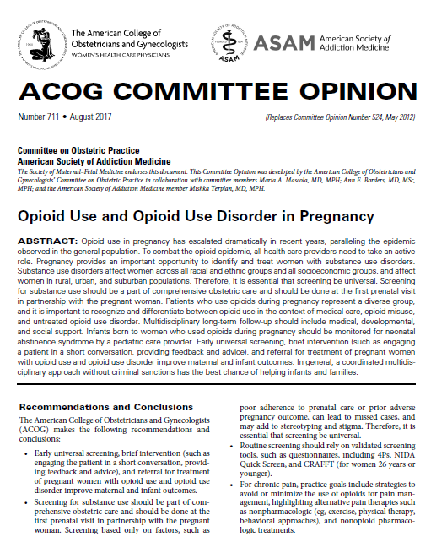
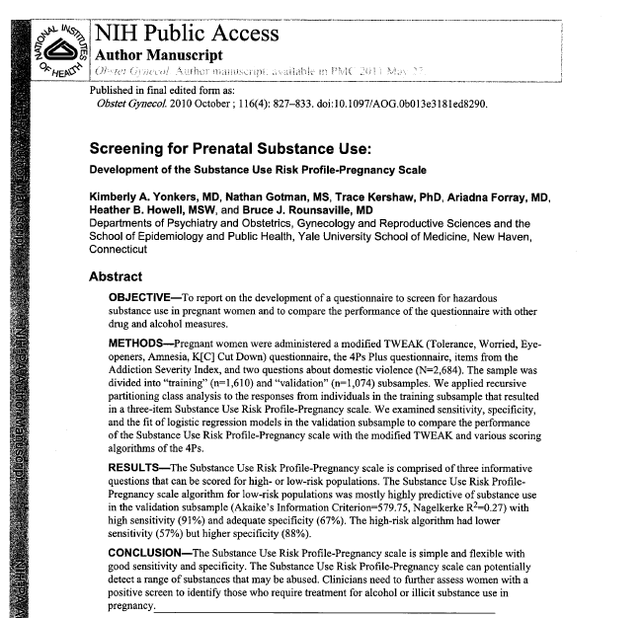
Screening vs. Testing per ACOG
Notes:
Speaker Notes:
Before pregnancy and in early pregnancy, all women should be routinely asked about their use of alcohol and drugs, including prescription opioids and other medications used for nonmedical reasons.
To begin the conversation, the patient should be informed that these questions are asked of all pregnant women to ensure they receive the care they require. Maintaining a caring and nonjudgmental approach, as well as screening when the patient is alone, are important and will yield the most inclusive disclosure.

Slide 30

ACOG Screening Guidance
Screening for substance use should be part of comprehensive obstetric care and should be done at the first prenatal visit in partnership with pregnant woman. Screening based only on factors, such as poor adherence to prenatal care or prior adverse pregnancy outcome, can lead to missed cases, and may add to stereotyping and stigma.
Early universal screening, brief intervention (such as engaging the patient in a short conversation, providing feedback and advice), and referral for treatment (SBIRT) of pregnant women with opioid use disorder improve maternal and infant outcomes.
Source: ACOG. Opioid Use and Opioid Use Disorder in Pregnancy. Opinion No. 711. ACOG Committee Opinion on Obstetric Practice & the American Society of Addiction Medicine. Replace Opinion No. 524, May 2012. Published August 2017.

Slide 31
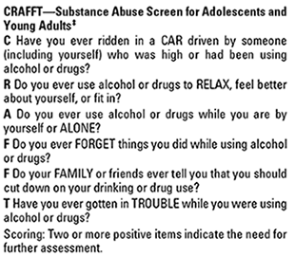
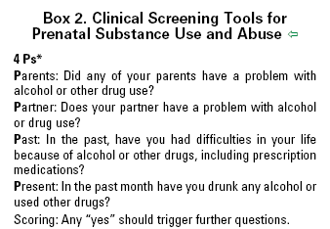
Examples of Screening Tools:
Source: https://www.acog.org/Clinical-Guidance-and-Publications/Committee-Opinions/Committee-on-Obstetric-Practice/Opioid-Use-and-Opioid-Use-Disorder-in-Pregnancy

Slide 32
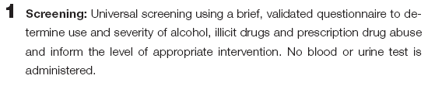
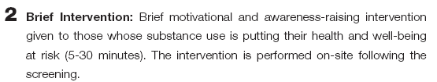

Typical Screening Tool Results
About 25% of patients screened will require a brief intervention, while 4% will need a referral to specialty treatment. the remaining 70% includes abstainers and low risk users who will simply require positive reinforcement for continuing to abstain, or reduce use to lower-risk levels.
Sources: https://www.oasas.ny.gov/admed/sbirt/index.cfm

Slide 33
Practice Approach Algorithm Following a Positive Screen or Disclosure of Probable Opioid Use Disorder
If no inclination of practice to embrace patients entirely, decision to disccharge patient to another OBGYN in area
Full range of patient care offered at your practice including
buprenorphine trained provider(s)
Patient obstetric care provided & referred out/co-managed for medication-assisted treatment
Be accepting, use navigator if needed, make referrals and support
Use provider guide and link up patient to MAT provider then provide routine care
Use provider guide to link up patients to another OBGYN in area – essential that patient be given all supports needed for positive pregnancy and hospital experience

Slide 34
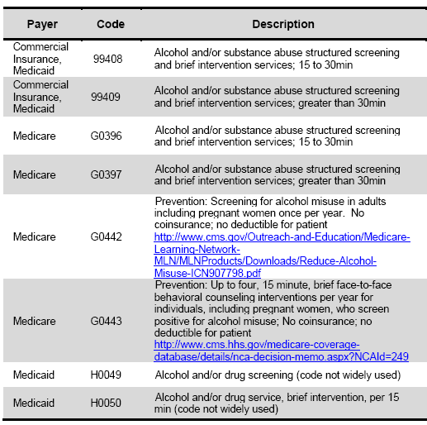
Screening tools are (supposed to be) BILLABLE!
Source: https://www.integration.samhsa.gov/sbirt/Reimbursement_for_SBIRT.pdf
Notes:
Speaker Notes:
Reimbursement for SBIRT:
The American Medical Association (AMA) has approved several billing codes that will allow you toe be reimbursed for providing screening and brief intervention services.
Medical procedures are coded using Common Procedure and Terminology (CPT) and Healthcare Common Procedure Coding System (HCPCS) codes.
Screening and brief intervention may be provided in an office, emergency department or inpatient visits for both new and established patients. Virtually all payers use AMA’s Evaluation and Management (E&M) CPT Codes to pay physician’s services.
Many payers reimburse for independent licensed health practitioners such as advance practice nurses, psychologists, and masters-level social workers. A few will pay for service provided by health professionals under the supervision of a physician. Several CPT codes can be used.
The chart above shows the most commonly used codes.

Slide 35
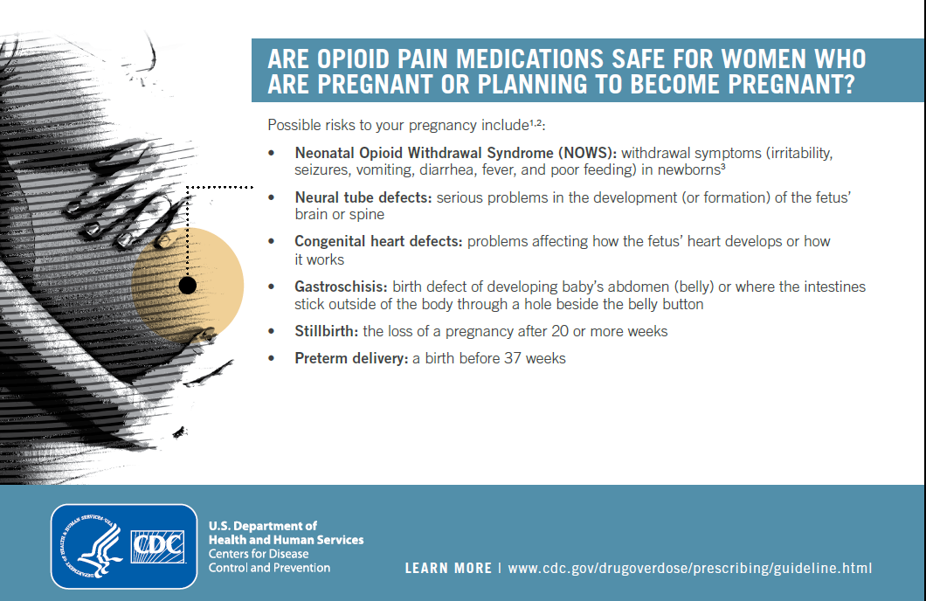

Slide 36
Why use Medication Assisted Treatments?
Used to avoid withdrawal – why?
Maintain abstinence from heroin or other opioids that have compromised various life areas and are unknown in quantity and dose
  Unbridled use of street heroin can have many serious health impacts on the unborn baby leading to life long issues including but not limited to heart defects, language and developmental issues, glaucoma, spina bifida, premature birth, low birth weights, etc.
  Mothers can be impacted by toxemia, communal infections, Hepatitis C, HIV, hypertension, miscarriage and even death
Used during pregnancy to provide overall safety for the pregnant woman and the fetus

Slide 37

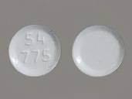
Medication Assisted Treatment (MAT) Options
Methadone
  Gold standard since 1960s for maintenance as well as to avoid withdrawl during detox. Category C by FDA
  Babies may be born with opioid acute withdrawl otherwise known as Neonatal Abstinence Syndrome (NAS)
Buprenorphine (Subutex)
  Babies born average weight and between 38-40 weeks
  Less traces of opioid in system therefore NAS usually less severe
Suboxone (Naloxone and Buprenorphine)

Slide 38
Treatment Services
EXAMPLE
Identify local SUD treatment facilities that provide women-centered care.
Ensure that drug and alcohol counseling and/or behavioral health services are provided.
Create better engagement and communication among providers within the continuum of care and across service areas, including the civil or criminal justice system.
Educate all providers of the importance of universal screening and have resources available for those screening positive (see slide x for NYS OASAS Treatment Services) OASAS live dashboard https://findaddictiontreatment.ny.gov or call HOPEline 877.846.7369
Contact local counties for a list of Substance Use Disorder Treatment Referral/Provider Directory (provide name of the contact by County) (see slide x)
Use of the Medicaid Cab program to schedule (five day advance notice) visits even if it brings patients two hours away from RPC and ensure Medicaid cab companies are involved in the solution

Slide 39
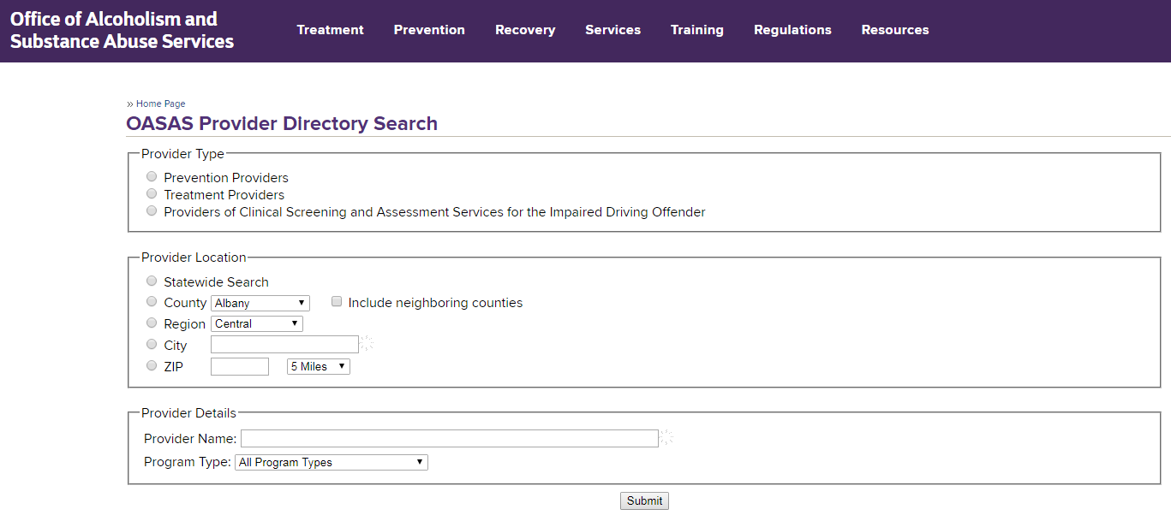
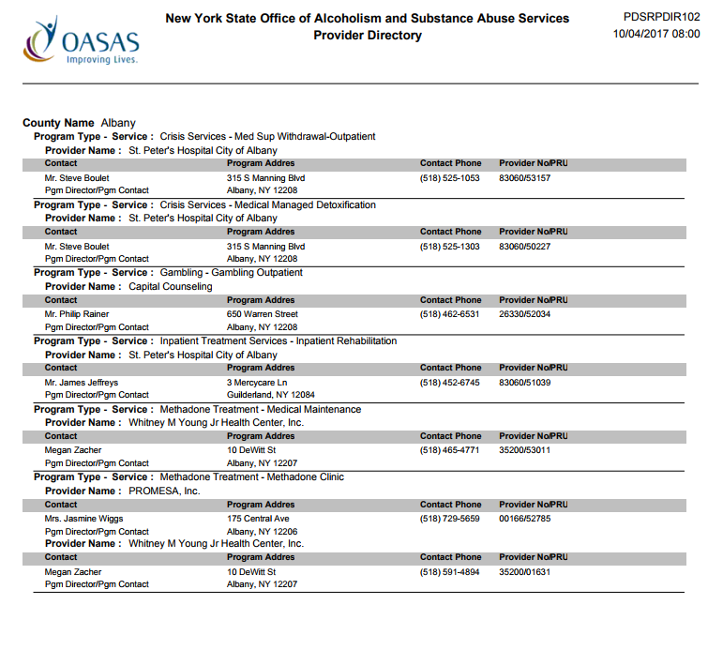
Resources
Sources: https://apps.oasas.ny.gov/reports_doc/TreatmentDirectory.pdf
https://oasas.ny.gov/providerDirectory/index.cfm
Notes:
Hardcopy sample provided

Slide 40
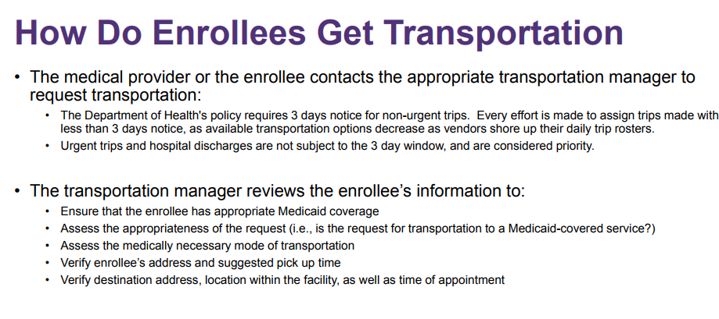
Resources
New York State Medicaid Cab Services
Currently the Department contracts with two Transportation Managers
• Medical Answering Services, LLC • All Counties North of NYC - https://www.medanswering.com (800) 850-5340 (24 hours a day, 7 days a week)
• LogistiCare Solutions, LLC
New York City - http://www.nycmedicaidride.net (877) 564-5911 (24 hours a day, 7 days a week)
Long Island - https://www.longislandmedicaidride.net (844) 678-1101 (24 hours a day, 7 days a week)
Created by ACOG District II in 2018
Notes:
https://www.health.ny.gov/health_care/medicaid/redesign/dsrip/docs/2015-12-17_medtrans_overview.pdf
Questions, Comments, Concerns Department of Health Medicaid Transportation Unit medtrans@health.ny.gov (518) 473-2160

Slide 41
Reduce the Stigma of using MAT
Change perceptions of opioid use disorder through the use of a common language and emphasize that SUDs are chronic medical conditions that can be treated.
Strive to use language that helps reduce stigma, accurately reflects science, promotes evidence-based treatment, and demonstrates respect for patients. For example, replace “drug abuser” with “person with a substance use disorder” or “in recovery” rather than being “clean.” (see slide 21 for more examples)
Develop tools to educate multidisciplinary teams of providers on the use of non-judgmental and harm-reduction focused language and learn how to acknowledge and change implicit biases of providers. Engage all staff in training, including clinical, administrative, and all other office personnel.
Notes:
Speaker Notes:
Expand upon bullet #1: screen for social determinants of health for example, pregnancy may be an opportunity for women, their partners and other people living in their household to change their patterns of substance use. Providers who care for women with opioid use disorder in pregnancy need to understand the complexity of the woman’s social, mental and physical problems in order to provide appropriate advice and support throughout pregnancy and in the postpartum period. (World Health Organization, 2014)

Slide 42
How does your office practice enhance patient & her family engagement?
Provide education to promote understanding of opioid use disorder (OUD) as a chronic disease – if your practice needs help – call Navigator or PDA.
Engage the patient and her family (if patient desires) early on in the process and care plan.
Allow a woman to describe her family dynamic and define who she would like to engage in the process.
Know the answers to these common questions to assist in engaging the patient and managing their expectations such as:
  Am I hurting my baby?
  Is Medication Assisted Treatment (MAT) safe for my baby?
  What is the role of child protective services (CPS) and what requires a notification or a report to CPS?
  Will my baby be taken away from me if I am using? Are there issues with specific drugs?
  Breastfeeding recommendations ?
  What is Neonatal Abstinence Syndrome (NAS) and what are the long-term effects of NAS?
Notes:
Speaker Notes:
Treatment will look different at every hospital, and will depend on the severity of the baby’s withdrawal.

Slide 43
Practice support of patient (continued)
Utilize motivational interviewing techniques and communicate positive stories of people with substance use disorders to engage the patient in her care.
Provide written information for the patient and her family that addresses her key concerns (assess patient health literacy to improve comprehension)
Help arrange a specific prenatal consultation visit with a neonatologist, NNP, or social worker to provide the patient facts of what happens at hospital /NICU to educate the patient and her family on the care of the baby following delivery, including discussion of:
  Neonatal Assessment & Breastfeeding recommendations
  The NAS scoring system tool – empower patient by reviewing components of assessment systems, discuss the limitations of the tool and strategies for engaging mother in the process
  The role of Child Protective Services
Notes:
Speaker Notes:
Sometimes patients need to be read to, and the patient should consider writing down notes or her goals to demonstrate that she has absorbed and truly grasp the concepts and information provided.

Slide 44
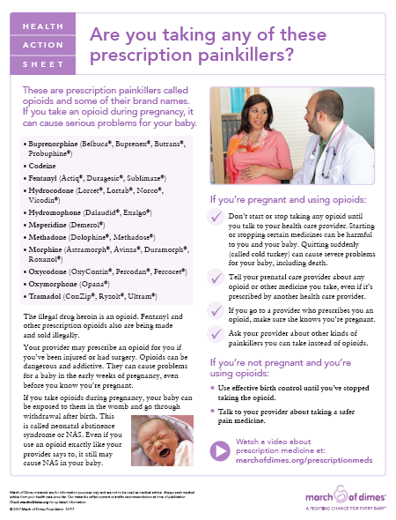
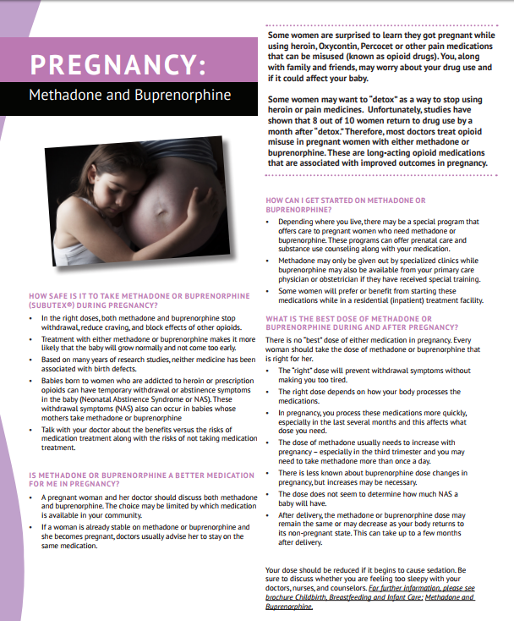

Resources
Sources: https://www.marchofdimes.org/pregnancy/prescription-opioids-during-pregnancy.aspx
https://pcss-o.org/wp-content/uploads/2015/10/WAGBrochure-Opioid-Pregnancy_Final.pdf
Created by ACOG District II in 2018

Slide 45
Pain Management Strategies: Practice-Based
Develop pain control protocols that account for increased pain sensitivity and avoidance of mixed agonist-antagonist opioid analgesics.
Educate all providers in your practice on strategies to avoid or minimize the use of opioids for pain management, highlighting alternative pain therapies such as nonpharmacological (eg, ), and non-opioid pharmacologic treatments.
Ensure awareness of dosage needs throughout the phases of pregnancy including addressing pain medication with patients and appropriate hospital staff at delivery.
  - If the patient is in long labor, she may need to use her maintenance therapy medications during labor and possible option to increase dose of the MAT to manage pain.
Patient needs letter from MAT to bring to the hospital to ensure that her dosing is appropriate and to demonstrate continued involvement in MAT program – it makes a difference to have this letter!
Notes:
Speaker Notes:
A shared decision making approach is essential

Slide 46
Readiness Key Words – use these when talking with patient
Stigma/bias/discrimination (choosing the appropriate language)
Chronic disease
Treatment
Education
Family/patient engagement
Care Coordination
Multidisciplinary care coordination
Antenatal, intrapartum, postpartum planning
Pain control
Know guidelines and statutes
Know best resources
Notes:
Speaker Notes:
Education for ob-gyns & family practice providers who deliver patients

Slide 47
How does your birthing hospital
handle patients with SUD – what is
their philosophy? You need to know!
Next Steps

Slide 48
Mercy, Mount St. Mary’s and Sisters Hospitals
Very involved committee for nearly 8 years focused on Substance Use in Pregnancy
Collaboration with STAR program led by Dr. Paul Updike and OBGYN Chad Strittmatter, MD – led by Terri Winner, NNP, Clinical Nurse Specialist in NICU
Multi-disciplinary team including social work, NICU, OB, Pediatrics, outpatient, mental health, administration, homecare, community providers (Kaleida, Seneca Nation, Davina Moss-King (Positive Direction), UB, etc.)
Devoted to compassionate care for mothers and babies with any substance use disorder
Standard policies and education at all three sites re: approach to Neonatal Abstinence Syndrome
Notes:
Speaker Notes:
Sometimes patients need to be read to, and the patient should consider writing down notes or her goals to demonstrate that she has absorbed and truly grasp the concepts and information provided.

Slide 49
Delivery Staff Need to be Aware of MATs
Staff in Labor and Delivery want and need to know about patient’s medication history, particularly if they are taking MAT
Goal is to communicate with mom about her needs, openly share about her situation and ensure she has what she needs for a safe and comfortable delivery
Letter from the patient’s MAT provider is a key compontent to prenatal record or other information that comes in with the patient
Patients are NOT all automatically “urine toxed” when they come in. They are screened and then determined to see if further testing is needed.
Notes:
Speaker Notes:
Sometimes patients need to be read to, and the patient should consider writing down notes or her goals to demonstrate that she has absorbed and truly grasp the concepts and information provided.

Slide 50
Pain Management Strategies: Hospital-Based
All hospitals should have pain control protocols that account for increased pain sensitivity and avoidance of mixed agonist-antagonist opioid analgesics.
Educate providers on strategies to avoid or minimize the use of opioids for pain management, highlighting alternative pain therapies such as nonpharmacological (eg, exercise, physical therapy, behavioral approaches), and non-opioid pharmacologic treatments.
Ensure awareness of dosage needs throughout the phases of pregnancy including addressing pain medication with patients and appropriate hospital staff at delivery.
  - If the patient is in long labor, she may need to use her maintenance therapy medications during labor and possible option to increase dose of the MAT to manage pain.
Share ‘Withdrawal” order set for pregnancy patients (include anesthesia, pharmacy, OBs, and neonatologists/pediatricians) (see slide x for sample order set)
Created by ACOG District II in 2018

Slide 51
Hospitals have plans for Safe Care
Engage appropriate partners (eg, social workers, case managers, legal services if available) to assist patients and families in the development of a “plan of safe care” for mom and baby.
Develop patient-specific care plans to enhance communication among treating providers that detail prenatal, labor and delivery, postpartum and newborn care as well as a plan of safe care after hospital discharge.
  Representatives from all care disciplines who interact with the patient should be engaged in development of the plan, including obstetrics, pediatrics, neonatology, patient advocates, behavioral health, social worker/case managers, anesthesiology, and addiction.
  Identify a case manager to oversee transition of the patient.
  Hold regular meetings to review cases and coordinate care management.
Notes:
Speaker Notes:
Create better engagement and communication among providers within the continuum of care and across service areas, including the civil justice system.

Slide 52
Plan of Safe Care (continued)
Talk with mom about ensuring she has thought about safe care for herself and her baby after delivery
  Ensure access and referral to support in the community for breastfeeding, postpartum care, including depression screening and family planning, social services following release from health care providers
  Catholic Health is very pro-breastfeeding as benefits of bonding outweigh minimal exposure to medications
Hospitals should address the health and substance use disorder treatment needs of the baby and family
Ensure mom has a plan for continuity of care post delivery – a safe house to care for her baby, MAT provider, crib, car seat, etc.
Notes:
Speaker Notes:
Add the conversation of a “plan of safe care” to the conversation during specific trimester teaching and incorporate a Perinatal Network referral to assist with community resources and connections.

Slide 53
Neonatal Abstinence Syndrome (NAS)
Provide education regarding neonatal abstinence syndrome (NAS) and newborn care
Infants born to women who used opioids during pregnancy should be monitored by a pediatric care provider for neonatal abstinence syndrome (NAS), a drug withdrawal syndrome that opioid-exposed neonates may experience shortly after birth.
  Engage patients early on in care and inform them to seek a pediatrician around their third trimester
  Ensure awareness of the signs and symptoms of NAS
Include interventions to decrease NAS severity (eg, maternal-infant bonding and breastfeeding, smoking cessation)
Educate patient that baby may cry inconsolably, have seizures and experience GI issues as well
Symptoms can appear 3 hours to 12 days after birth
Babies stay minimum of 5 days at CHS hospitals
Notes:
Speaker Notes:
Ensure childbirth education programs cover some discussion to various medication use during pregnancy and encourage mom to ask more questions after class (goal to trigger mothers to talk about potential opioid use)

Slide 54
NAS: Signs to Watch For
Increased muscle tone “tightness”
Poor eating or vomiting. Often, babies look like they want to eat, but they are not able to suck and swallow at the same time. Instead, they may take in a lot of air and become frantic, not able to eat. This can cause them to lose weight and have trouble putting weight back on
Source: Catholic Health Women Care NAS Pamphlet
*Use a modified NAS scoring system (eg, Finnegan’s, NWIS)
Notes:
Speaker Notes:
Providers need to know the process at their hospital for delivery and need to inform women that the baby will be observed for a period of time to assure a healthy beginning. (include post-hospital discharge signs/symptoms)

Slide 55
NAS: Signs to Watch For
High pitched or long periods of crying or fussiness. Often, a lot of loud high pitched crying occurs and it may be difficult to quiet your baby. Long periods of being unsettled can cause your baby to use up a lot of calories and lose weight
Trouble sleeping. Without enough sleep, they tire out and are not able to eat properly
Source: Catholic Health Women Care NAS Pamphlet
*Use a modified NAS scoring system (eg, Finnegan’s, NWIS)
Notes:
Speaker Notes:
Providers need to know the process at their hospital for delivery and need to inform women that the baby will be observed for a period of time to assure a healthy beginning. (include post-hospital discharge signs/symptoms)

Slide 56
NAS: Signs to Watch For
Tremors or shaking. Your baby may not be able to control his/her movements or self-console
Diarrhea. This will cause your baby to lose weight and also puts skin in jeopardy of breakdown due to frequent stools
Fever or sweating. Babies cannot control their temperature well, and sweating uses up a lot of calories
Source: Catholic Health Women Care NAS Pamphlet
*Use a modified NAS scoring system (eg, Finnegan’s, NWIS)
Notes:
Speaker Notes:
Providers need to know the process at their hospital for delivery and need to inform women that the baby will be observed for a period of time to assure a healthy beginning. (include post-hospital discharge signs/symptoms)

Slide 57
NAS: Signs to Watch For
Frequent yawning or sneezing
Difficulty breathing because of a stuffy nose, fast breathing, or forgetting to breathe
Breakdown of skin on face or knees because of rubbing on the linen. This can also happen if baby is unable to self-console
Possible seizures
Source: Catholic Health Women Care NAS Pamphlet
*Use a modified NAS scoring system (eg, Finnegan’s, NWIS)
Notes:
Speaker Notes:
Providers need to know the process at their hospital for delivery and need to inform women that the baby will be observed for a period of time to assure a healthy beginning. (include post-hospital discharge signs/symptoms)

Slide 58
Treatment Options for NAS
Swaddling
Cuddling
Movement but with minimal sound and light
Pharmacological interventions including morphine
Bonding time with mom and/or dad
Source: Catholic Health Women Care NAS Pamphlet
*Use a modified NAS scoring system (eg, Finnegan’s, NWIS)
Notes:
Speaker Notes:
Providers need to know the process at their hospital for delivery and need to inform women that the baby will be observed for a period of time to assure a healthy beginning. (include post-hospital discharge signs/symptoms)

Slide 59

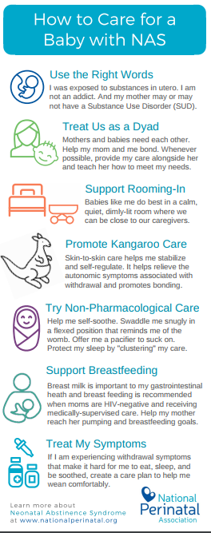
Resources
Sources: Catholic Health National Perinatal Association

Slide 60
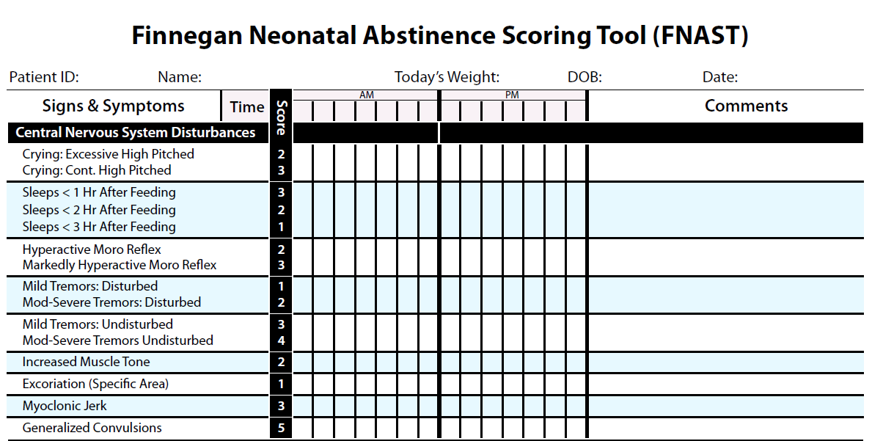
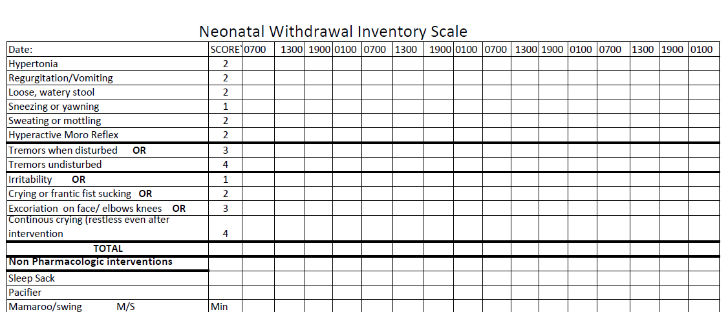
Scoring tools – see handout

Slide 61
Discharge Plans from Hospital
Extremely important for the discharge planner from the hospital communicate with the Mom’s outpatient counselor at the CD facility or the OMT facility
CD Counselor will need to follow-up with a treatment plan that will be conducive for the Mom and the baby as well

Slide 62
How can I get patients to share
information to manage treatment?
MOTIVATIONAL INTERVIEWING

Slide 63
Motivational Interviewing (MI)
is a method of conversational style that works on facilitating and engaging intrinsic motivation within the client in order to change behavior.
MI is a goal-oriented, client-centered counseling style for eliciting behavior change by helping clients to explore and resolve their ambivalence.
Rollnick, S. & Miller, W. R. (2013). Motivational Interviewing: Helping people change 3rd edition (Applications of Motivational Interviewing). The Guildford Press: New York.

Slide 64

Motivational Interviewing
Developing a therapeutic alliance with the four processes in Motivational Interviewing (MI) a collaborative approach.
Engaging
Focusing
Evoking
Planning

Slide 65
Language of Motivational Interviewing
Medical Professional
Patient
How may I help ?
May we spend more time discussing this…?
I understand this is difficult…
You appear confident with your choice…
Desire to change
Ability to change
Reasons to change
Need to change
*******************
Commitment
Taking steps to change

Slide 66

Spirit of MI (2013)
Collaborative
Compassion
Evocation
Acceptance

Slide 67
Spirit of MI
MI begins with a partnership between the patient and the physician
MI is a collaboration to provide support
MI is skillful guidance from the medical staff
The ultimate goal is for the patient to change their behavior with out persuasion
Rollnick, S. & Miller, W. R. (2013). Motivational Interviewing: Helping people change 3rd edition (Applications of Motivational Interviewing). The Guildford Press: New York.

Slide 68
Core Skills - OARS
O – Open Questions
A – Affirming
R – Reflecting
S - Summarizing

Slide 69
Collaboration
MI is done “for” and “with” a patient
Looking to the patient’s expertise about their illness or physical well-being
Conversation that is continuous skill building

Slide 70
Compassion
Give priority to the patient’s needs
Establishes a working partnership
Deliberate commitment to pursue the best interests of the patient

Slide 71
Acceptance
Acceptance has four components
Absolute Worth: basic trust and respect
Accurate Empathy: understand the patient’s worldview
Autonomy Support: honoring and respecting the patient’s self - direction
Affirmation: acknowledge the patient’s strengths and efforts

Slide 72
Exploring Values
Value system may conflict with the counselor’s
Explore the value of not participating in substance use activities
Explore the value of what is most important
Explore how is pregnancy adjacent or conflicting with the current values

Slide 73
Evocation
Strengthen the change motivations that the patient has within.
Install facts of a disease, condition or a disorder that will improve if a change is made

Slide 74
Three focused communication styles
Following
Directing
Guiding
Rollnick, S., Miller, W., & Butler, C. (2007). Motivational Interviewing in Health Care: Helping Patients Change Behavior. New York: Guilford Press.

Slide 75
Ostlund, A et. al. (2015)
Motivational Interviewing techniques were useful rather than giving the traditional advice (authoritative relationship vs. partnership in the health care relationship)
Facilitated some change – difficult to make a change for negative health habits
Medical staff had a concern about time pressure
Interaction with the patient was successful (Increase self – efficacy to make a change)
Ostlund, A. er. Al. (2015). Primary Care nurses’ performance in Motivational Interviewing: a quantitative descriptive study. BMC Family Practice 16:89.

Slide 76
Ingersoll, K. S. et. al. (2013)
Used Motivational Interviewing along with literature, videos and education in the first session with an assessment / screening tool
Consecutive sessions showed a decrease in alcohol use vs. only one session which showed limited difference in alcohol consumption
Prevention and Intervention with MI is successful
Ingersoll, K., Ceperich, S., Hettema, J., Farrell-Carnahan, L., & Penberthy, K. (2013). Preconceptional motivational interviewing interventions to reduce alcohol-exposed pregnancy risk. Journal of Substance Abuse Treatment , 44, 407-416.

Slide 77
Following Style
Follow the lead of the patient to understand
his / her worldview
Listening without instructing
Building trust
Reserve opinions / thoughts
Giving full attention to the patient / family

Slide 78
Directing Style
Explain area of expertise in relationship to the current situation
Give knowledge in short sentences
Asking permission to give the knowledge

Slide 79
Guiding Style
Giving encouragement
Using the spirit of MI to enlighten the
patient / family
Providing Support / Providing Resources

Slide 80
Values that influence behavior(s)
Personal Values
Professional Values
Respect
Love
Relationships
Integrity
Compassion
Altruism

Slide 81
Values, continued
Values influence beliefs and may lead an individual to evaluate his / her behavior as well as others.
Evaluate the stability of an individual’s:
  Culture
  Social class
  Personal decisions
Sharma, R. & Jha, M. (2017). Values influencing sustainable consumption behaviour: Exploring the contextual relationship. Journal of Business Research, 76, p. 77-88.

Slide 82
Conflict of Values Results
Medical Professional
Patient
Frustration
Powerless
Anger
Communication
Fear Change
Frustration
Past Experiences
Communication

Slide 83

A Values Card Sort
Most important
Very important
Somewhat important
Not important

Slide 84

Values Cards – see yellow handout

Slide 85
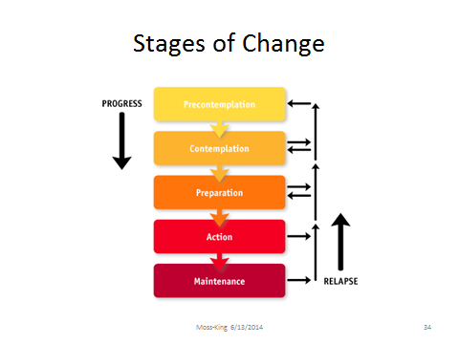
Stages of Change (DiClemente, 2006)

Slide 86

Example of Motivational Interviewing
https://youtu.be/EvLquWI8aqc

Slide 87
Jodi
Jodi is a 26 year old pregnant female that currently has a three year old son. Jodi is married and she and the husband are currently in an Medication Assistance Therapy program together. Jodi is currently 4 months pregnant and has been referred to your agency to begin organizing her treatment. Jodi admits that she stopped using heroin during her 15th week of pregnancy and admits she is experiencing cravings but is trying to “fight” them off by purchasing suboxone from a friend.
Please pair up and consider the following questions (10 minutes):
How would you use Motivational interviewing to obtain information?
How would you phrase your questions – keeping in mind the information that was discussed previously
Recommendations?

Slide 88
Inside the patient’s mind,
in her heart, how did
she get ‘here’?
TRAUMA INFORMED CARE

Slide 89

Trauma-Informed Care
Provide training regarding trauma-informed care to your staff.
*It is important that the staff who use motivational interviewing, recognize trauma-informed care as an element in the tapestry of a woman’s life.
Understand the neurobiology of trauma
Recognize the signs and symptoms of trauma in patients and families
Screen for physical and sexual violence (eg, consider using ACES screening 10 question as a guide)
Coordinate care with behavioral health/psychiatric care teams
Prevent re-traumatization
Seek someone in the community to educate your staff on Trauma- Informed Care, read articles and books, and recognize cues to help where staff need to go with questions.
  - Attend trainings provided by crisis centers/Universities
Created by ACOG District II in 2018
Notes:
Speaker Notes:

Slide 90

ACE - see pink handout

Slide 91
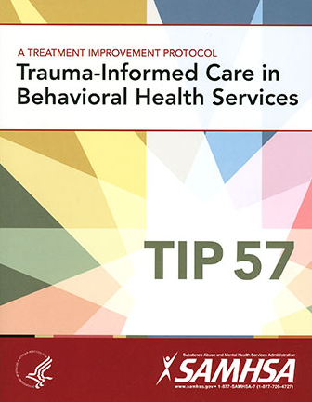

Resources
Source: https://www.ncjfcj.org/sites/default/files/Finding%20Your%20ACE%20Score.pdf
https://store.samhsa.gov/product/TIP-57-Trauma-Informed-Care-in-Behavioral-Health-Services/SMA14-4816
Created by ACOG District II in 2018

Slide 92
Types of trauma
Witnessing violence
Experiencing physical or mental abuse
Exposure of violence in the living environment
Sexual Abuse

Slide 93
The three E’s in Trauma
According to SAMHSA, individual trauma results from an:
Event, series of events, or set of circumstances that is…
Experienced by an individual as physically and/or emotionally harmful or threatening and that has lasting adverse…
Effects on the individual’s functioning and/or physical, social, emotional, or spiritual well-being.

Slide 94
R’s for Trauma Informed Approach
Realizing the prevalence of trauma
Recognizing how it affects all individuals involved with the program, organization or system, including its own workforce
Resisting re-traumatization
Responding by putting this knowledge into practice

Slide 95
Core Principles
Safety – ensuring physical and emotional safety
Trustworthiness – maintaining appropriate boundaries and making tasks clear
Choice – prioritizing (staff) consumer choice and control (people want choices and options; for people who have had control taken away, having small choices makes a big difference)
Collaboration – maximizing collaboration
Empowerment – prioritizing (staff) consumer empowerment and skill-building

Slide 96
7 Domains of Trauma-Informed Care
Early screening and comprehensive assessment
Consumer driven care and services
Trauma-informed, responsive and educated workforce
Emerging and evidence-informed best practices
Safe and secure environments
Create trauma-informed community partnerships
Develop a performance monitoring system

Slide 97

Trauma Informed Care (TIC)
https://youtu.be/z8vZxDa2KPM

Slide 98
Reactions to Trauma
Posttraumatic Stress – Recurring to arousal symptoms according to the DSM V. These symptoms are greater than 4 weeks.
Acute Stress Disorder – several prominent dissociative symptoms plus intrusive, avoidant, and hyper arousal symptoms and less than 4 weeks

Slide 99
Complex Trauma
3 or 4 types of trauma exposure is known as complex trauma
Negatively impacts a child’s development
Lasting effects are negative
Requires constant support
Requires mental health counseling focusing on strong relationships

Slide 100
Assessment
Counselor / Nurse / Health Care Professional will complete an assessment identifying the needs

Slide 101

Medical Staff Interaction
Observe
Contact the outside resources for assistance
Speak in an area that is private
Use your Motivational Interviewing Skills & Conversational styles
Use your tools

Slide 102

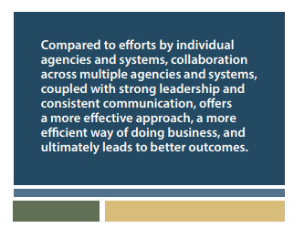
Resources
Source: https://store.samhsa.gov/product/A-Collaborative-Approach-to-the-Treatment-of-Pregnant-Women-with-Opioid-Use-Disorders/SMA16-4978
Created by ACOG District II in 2018

Slide 103
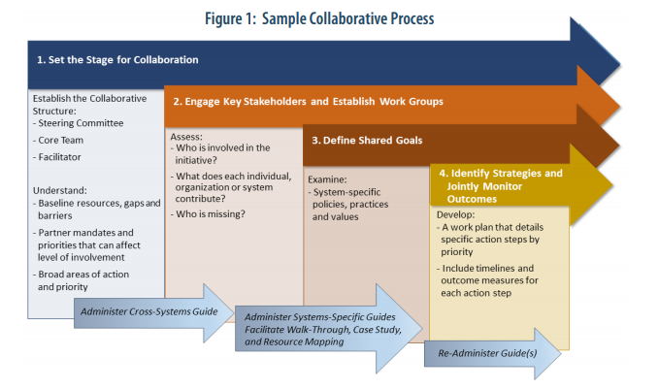
Resources
Source: https://store.samhsa.gov/product/A-Collaborative-Approach-to-the-Treatment-of-Pregnant-Women-with-Opioid-Use-Disorders/SMA16-497801
Created by ACOG District II in 2018
Notes:
https://store.samhsa.gov/product/A-Collaborative-Approach-to-the-Treatment-of-Pregnant-Women-with-Opioid-Use-Disorders/SMA16-4978

Slide 104
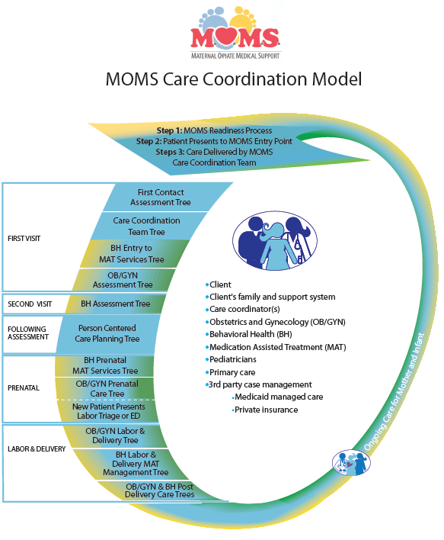
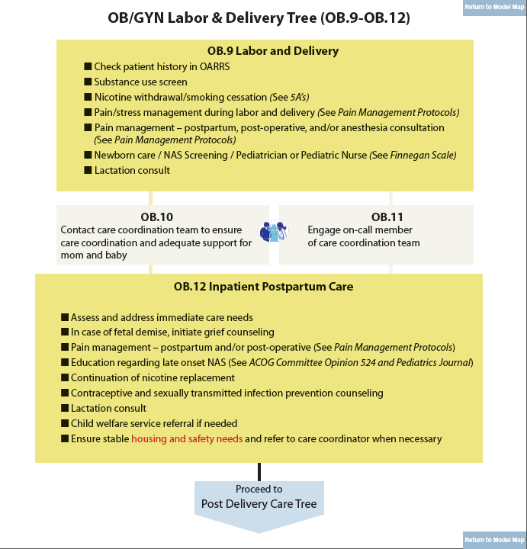
Resources
Source: http://momsohio.org/healthcare-providers/decision-trees/decisiontree-attributes/MOMS-Decision-Tree_F3_12-8-15.pdf
Created by ACOG District II in 2018

Slide 105


Slide 106
Positive Direction Model ™
Opioid Use & Pregnancy (2017)
Collaborates with the OBGYN
Communicates concerns regarding the recovery
Develops treatment plans and shares with the physicians involved with the patient
Provide intense education regarding effects of opioid use / other substances
Provide education on Neonatal Abstinence Syndrome

Slide 107
The counselor’s concerns
Health
Sobriety
Family
Living Supports
Mental Health
Prenatal and Postnatal
Infant (NAS)
Education

Slide 108

Positive Direction Model
OMT Provider
Navigator - Consultant
SUD Provider
Pediatrician
Pregnant
Woman
OB GYN
Behavioral Health Specialist
Positive Direction Model for Opioid Maintenance Treatment during Pregnancy

Slide 109
Creating Plans
Engage patients by using Motivational Interviewing
Familiarize yourself with the patient to understand her trauma and worldview
Endorse collaboration to work with the patient and her family
Integrate culturally relevant information that may be a barrier for successful treatment

Slide 110
PDM - Workbook
Demographics
Treatment Plan
Continuity of providers
Medication Assistant Therapy Letter
Info for my baby
Birthing Plan
Discharge Plans
Ready to Come Home Plan
Breastfeeding chart

Slide 111
Jodi
Jodi is a 26 year old pregnant female that currently has a three year old son. Jodi is married and she and the husband are currently in an Medication Assistance Therapy program together. Jodi is currently 4 months pregnant and has been referred to your agency to begin organizing her treatment. Jodi admits that she stopped using heroin during her 15th week of pregnancy and admits she is experiencing cravings but is trying to “fight” them off by purchasing suboxone from a friend.
Please return to your group and consider the following for the workbook:
One participant will role play Jodi and the other will use the motivational interviewing skills to encourage a positive change.
The participant that is Jody will think of 2 treatment plans to continue a safe pregnancy
The participant that is the observer will use the motivational interviewing language learned to state positive language statements to encourage Jodi.

Slide 112
Conclusion
Opioid use is a public health problem affecting women and children at alarming rates. As providers it is imperative to:
Consider a trauma informed care environment
Use motivational interviewing techniques to encourage a positive change
Understand substance use disorder as a medical illness to eliminate the stigma
Connect with community partners to lower the numbers of infants born exposed to opioids and / or other substances
Contact Catholic Health System or Positive Direction for consultation

Slide 113

Thank you
Questions
Concerns
Comments
Evaluation!

Slide 114


